Slide 1
LOGIC CIRCUITS
Individual homework
Exercise 4
Bledea Mihaela-Alexandra

Slide 2
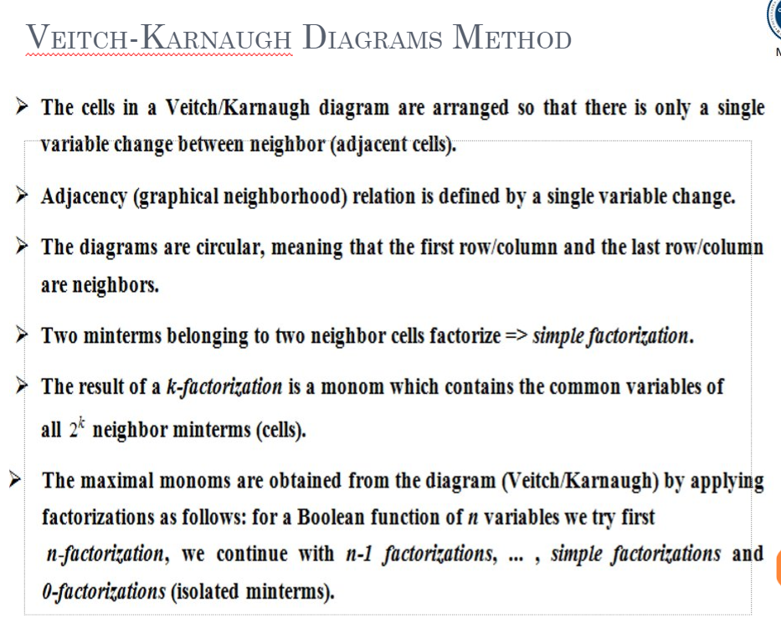

Slide 3

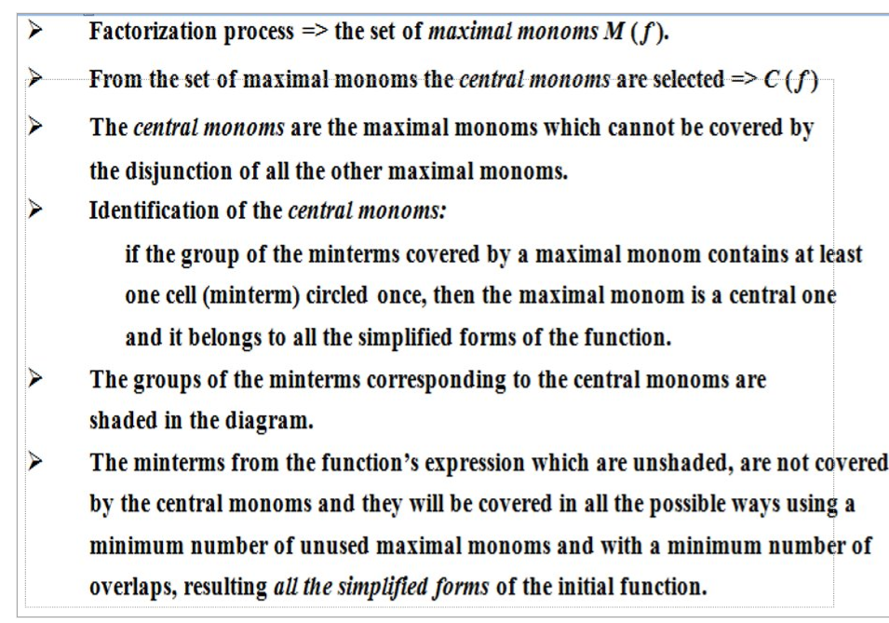

Slide 4
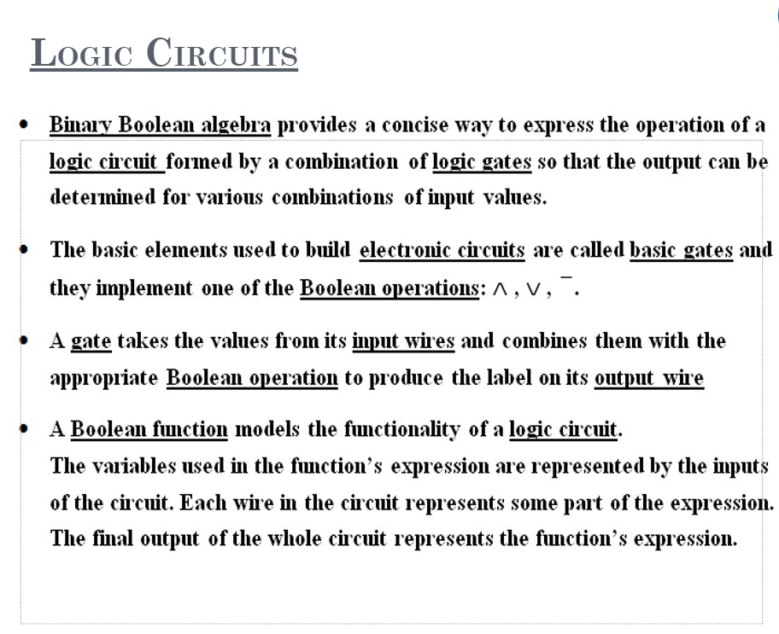

Slide 5
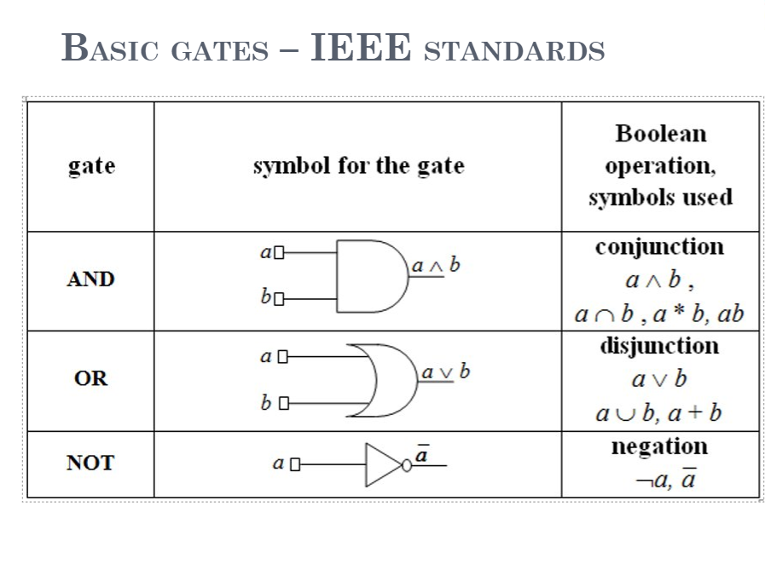

Slide 6
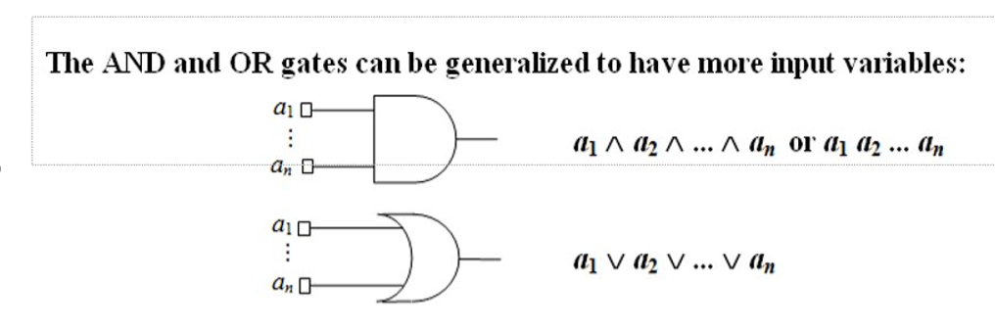

Slide 7
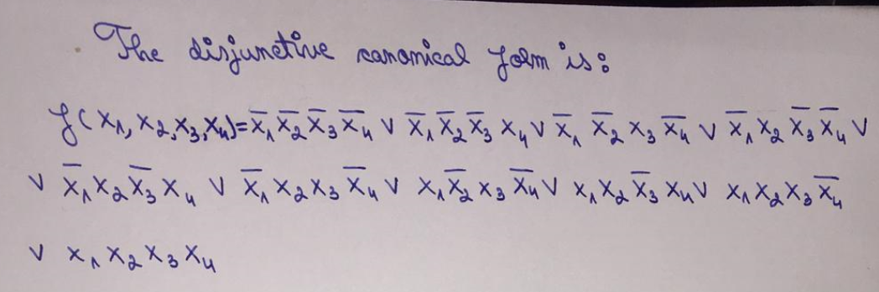
Exercise 4.
Write a Boolean function of 4 variables given by its table of values, simplify it and draw the logic circuits corresponding to all its simplified forms.
X1 | X2 | X3 | X4 | F(X1, X2, X3, X4)
0 | 0 | 0 | 0 | 1
0 | 0 | 0 | 1 | 1
0 | 0 | 1 | 0 | 1
0 | 0 | 1 | 1 | 0
0 | 1 | 0 | 0 | 1
0 | 1 | 0 | 1 | 1
0 | 1 | 1 | 0 | 1
0 | 1 | 1 | 1 | 0
1 | 0 | 0 | 0 | 0
1 | 0 | 0 | 1 | 0
1 | 0 | 1 | 0 | 1
1 | 0 | 1 | 1 | 0
1 | 1 | 0 | 0 | 0
1 | 1 | 0 | 1 | 1
1 | 1 | 1 | 0 | 1
1 | 1 | 1 | 1 | 1

Slide 8
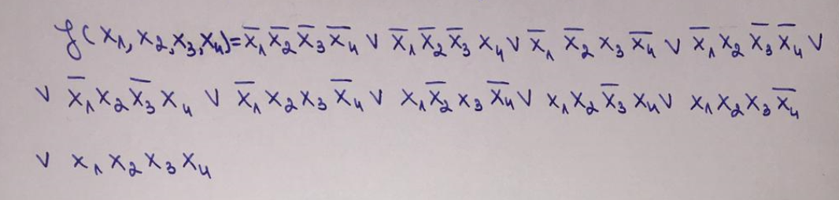

The disjunctive canonical form is:

Slide 9

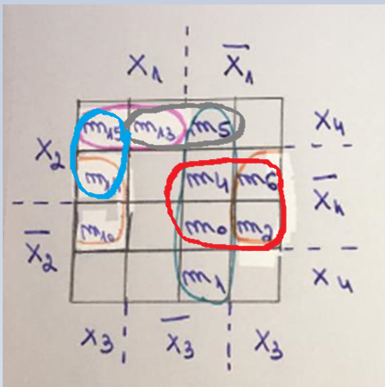


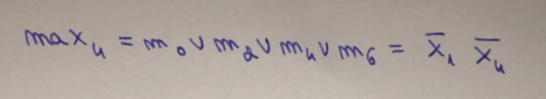


We use Veitch Diagram Method for finding the function’s simplified forms.
The set of maximal monoms →
M(f) = { max1, max2, max3, max4, max5, max6}
C(f) = {max 1, max2}
The set of central monoms →
g = max1 V max2
M(f) != C(f) and C(f) is not the empty set => We are in the second case of the simplification algorithm

Slide 10

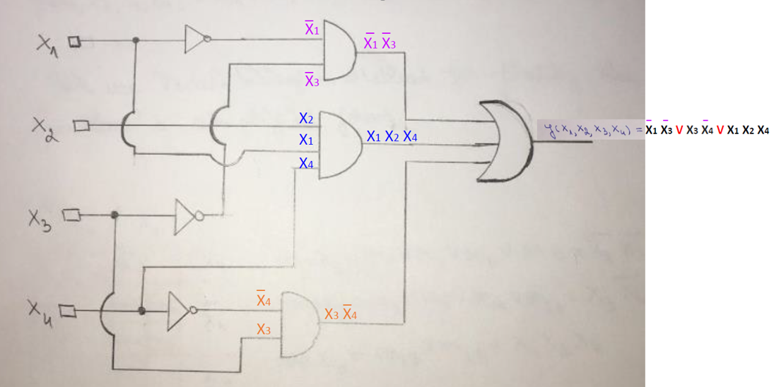
m15 is not covered by the central monoms and we can cover it in one way, using max3.
One simplified form of f is obtained:
f(x1, x2, x3, x4) = g V max3
f(x1, x2, x3, x4) = max1 V max2 V max3

